Slide 1
VOILA
Presented By:
Alok Srivastava (191500001)
Astha Jaiswal (191500175)
Ayushi Gupta (191500205)

Slide 2
OUTLINE
About the Project
Objective
Requirements
Snapshots from the website

Slide 3
ABOUT THE PROJECT
Our full stack project “VOILA” is an on-demand service platform. The platform helps customers book reliable and high quality services – beauty treatments, massages, haircuts, home-cleaning, appliance repair, vehicle repair, painting, carpenter, electrician, fitness and more – delivered by trained professionals conveniently at home.
We gather information of skilled and experienced professionals providing various home services and are looking to list their services on the platform.
Our match-making algorithm identifies professionals who are closest to the user’s requirements and available at the requested time and date.

Slide 4
OBJECTIVE
The primary objective of the Voila is delivering on-demand services at the door step in just one click. To develop a platform that allows skilled and experienced professionals in their respective professions to connect with users looking for specific services.
User friendliness: to design an interactive User Interface for seeking home services on the go.

Slide 5
REQUIREMENTS
Software Specification Used:-
Technology Implemented: Full-Stack Web Development
Languages/Technologies Used: Front-End Technologies
IDE Used: Visual Studio Code
Web Browser: Google Chrome, Brave

Slide 6
Hardware Used:
Operating System: Windows 10
RAM: 2 GB (Browser Supported)
Hardware Devices: Computer System
Hard Disk: 256 GB

Slide 7
THIS IS HOW OUR WEBSITE LOOKS
Hope you will like it :)

Slide 8
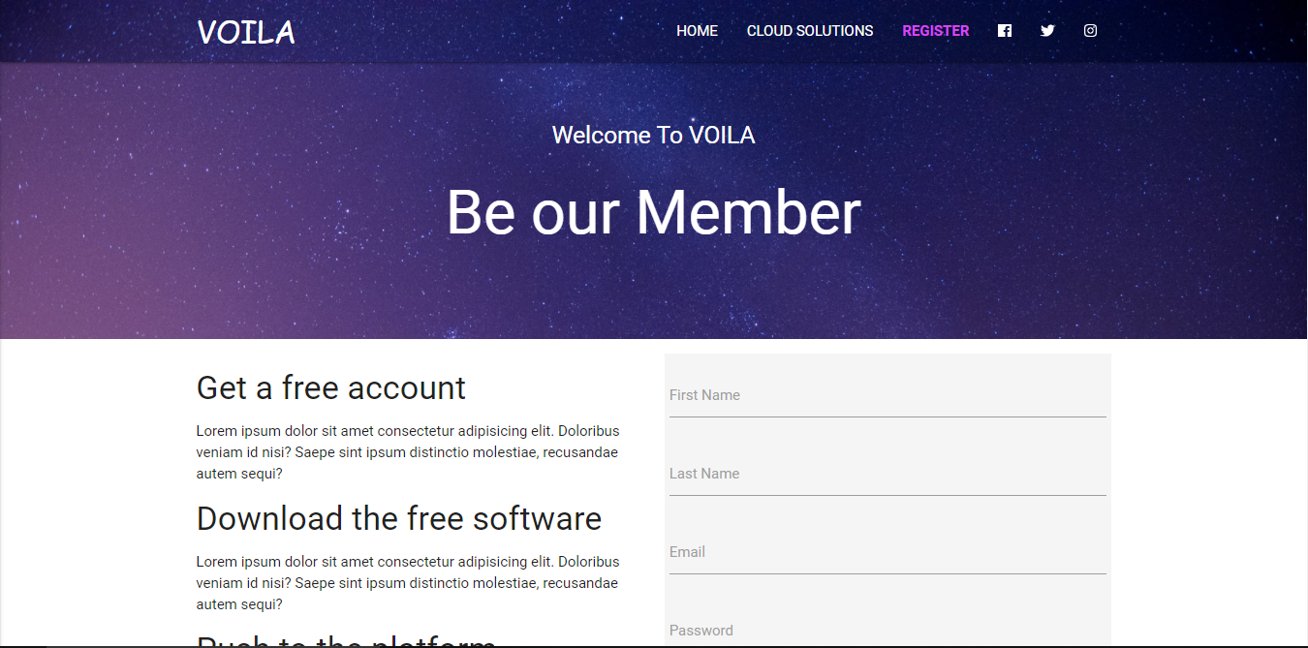
REGISTER PAGE

Slide 9
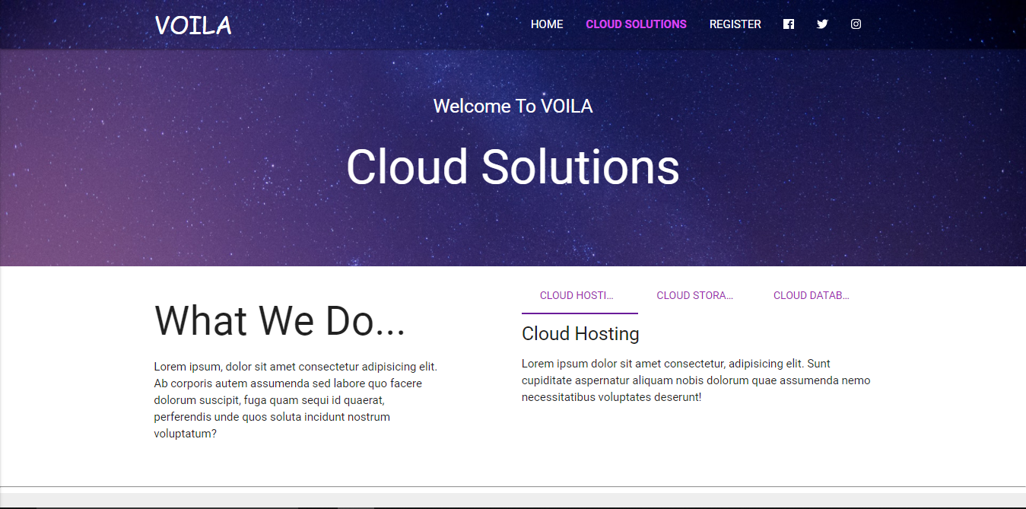
2. CLOUD SOLUTIONS PAGE

Slide 10
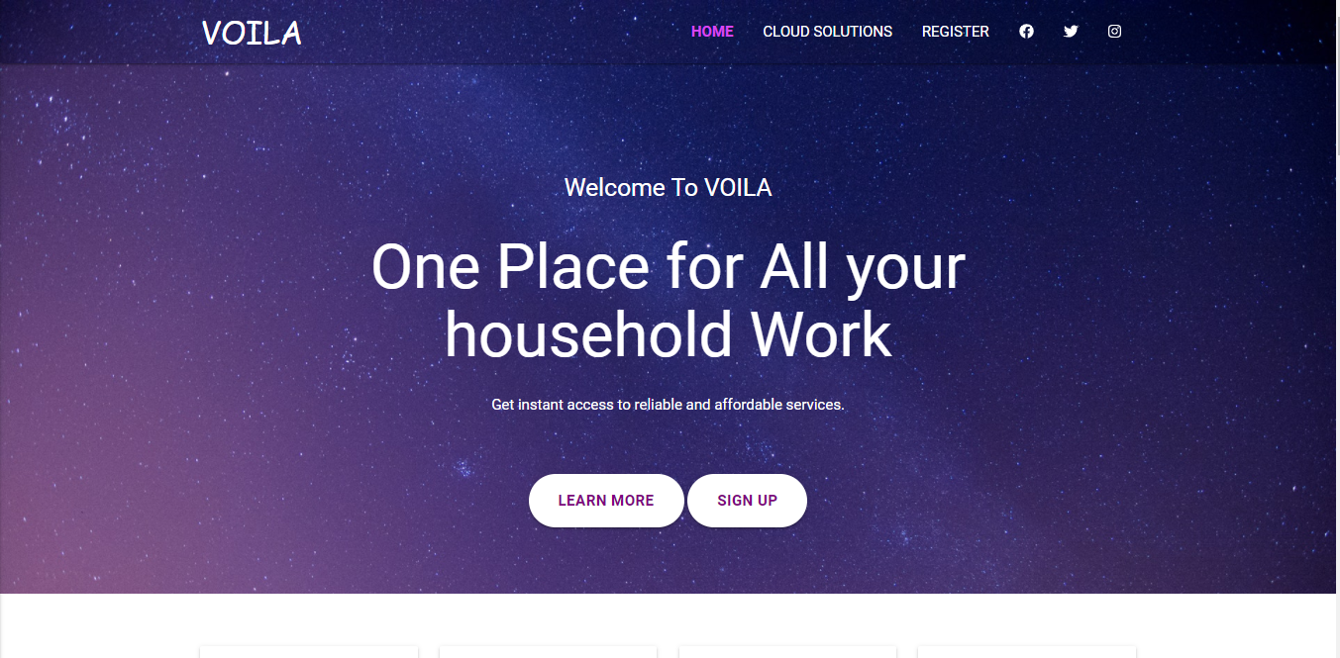
3. HOME PAGE

Slide 11
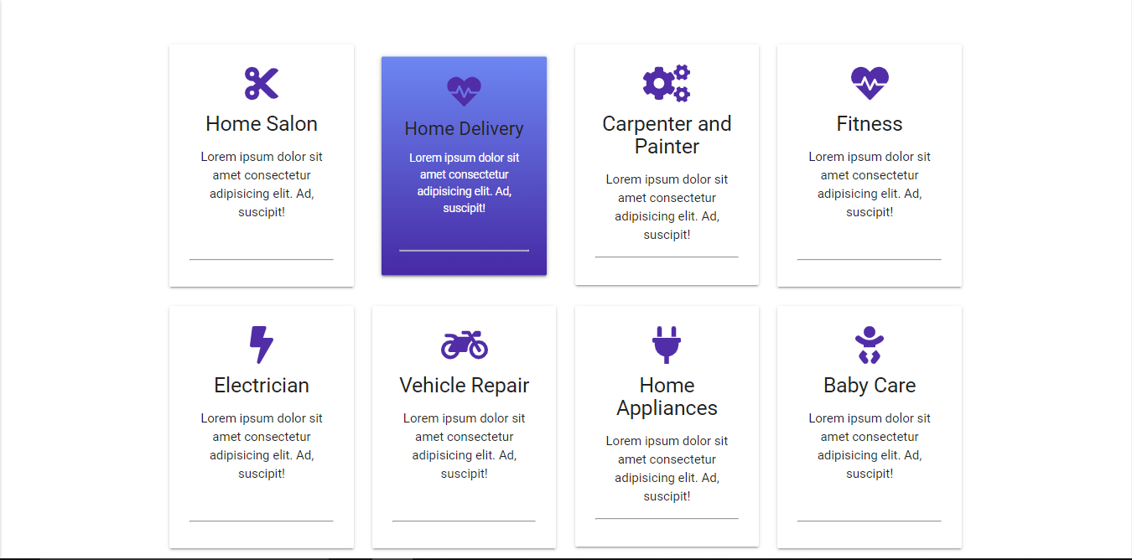
4. HOME PAGE - Cards

Slide 12

4. HOME PAGE - About Us

Slide 13
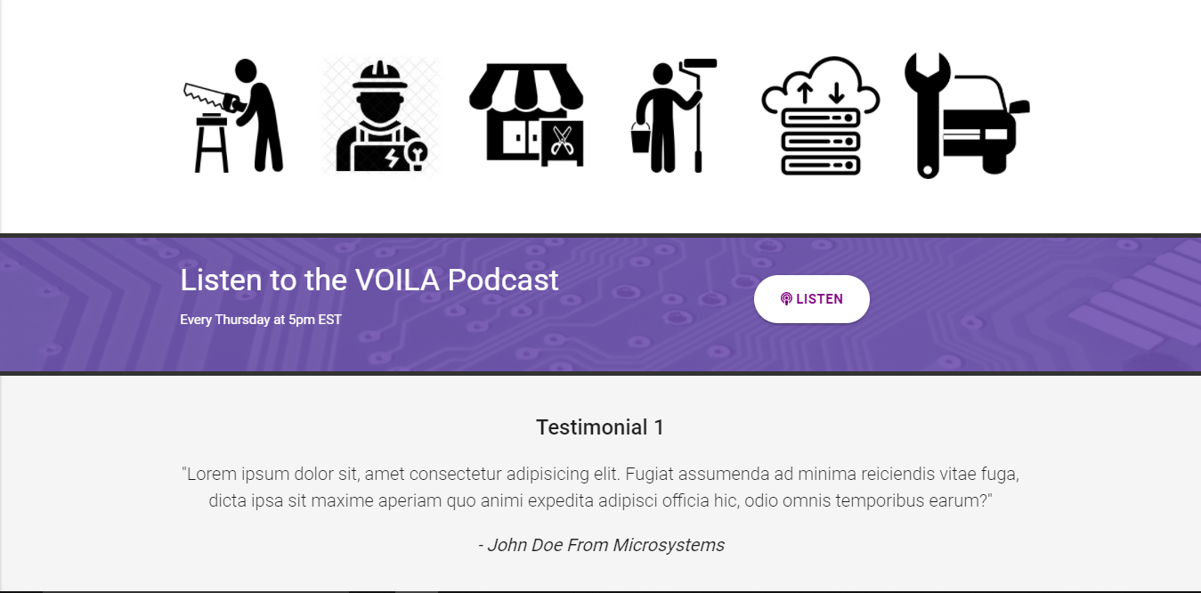
4. HOME PAGE – Icons / Testimonial

Slide 14
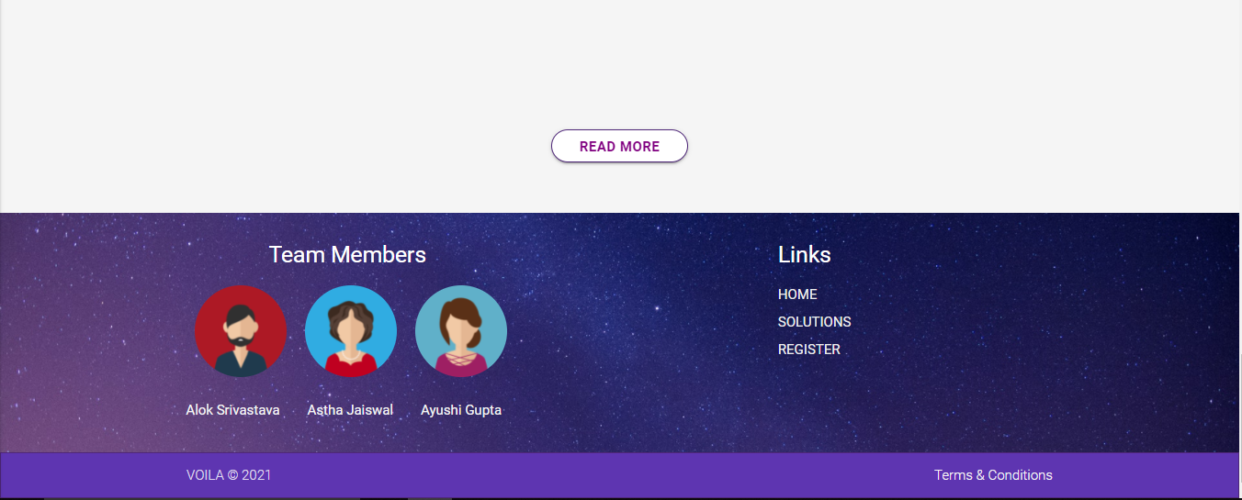
4. HOME PAGE – Footer

Slide 15
Thank You!!!

